Slide 1
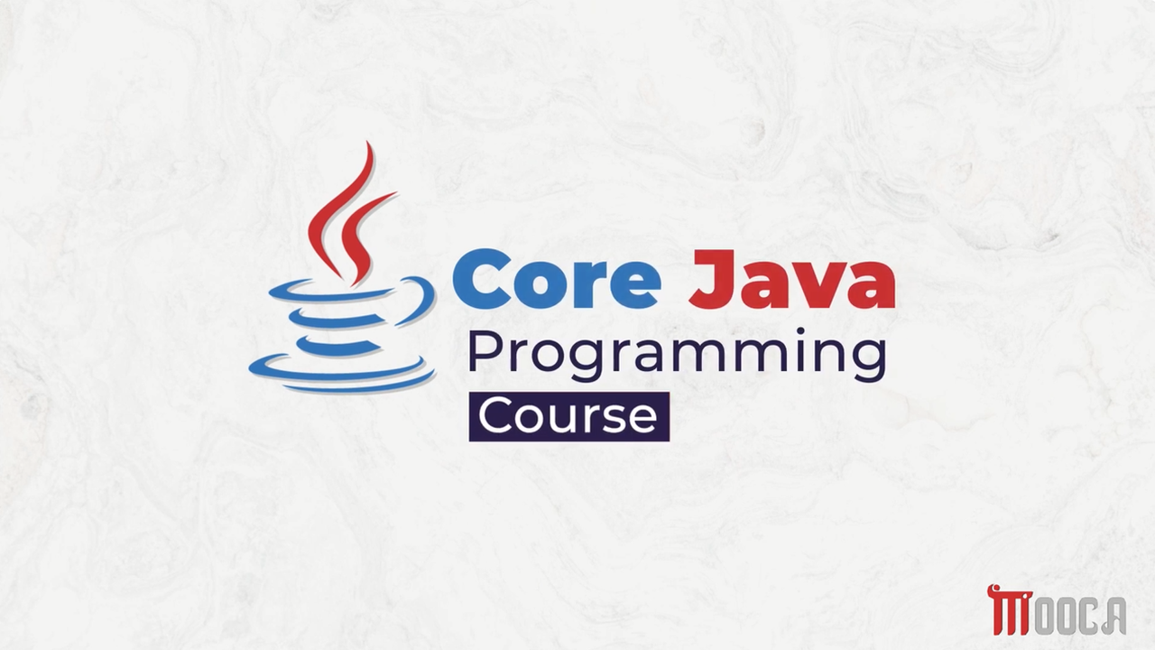

Slide 2
✍Learning Objectives
Define Java and understand its main characteristics.
Describe the history and evolution of Java.
Explain why Java was created.
Identify the key features of Java.
Compare Java with C++.
Understand JVM, JRE, and JDK.
Explain how Java programs are executed.

Slide 3
✍Core Java …
Lecture 2 :
Encapsulation
Inheritance and Polymorphism
First Java Program
Simple Operations with Variables
Control Statements Examples
Java Code Blocks
Java Lexical Issues
Lab 2 .

Slide 4
✍Lecture 3:
Primitive Data types .
Literals in java .
Variables .
Type Casting .
Arrays .
Lab 3.

Slide 5
✍Lecture 4 :
The Arithmetic and Bitwise Operators
The Relational and Boolean Logical Operators
The Ternary and instanceof Operators
Tha Arrow Operator and Lambda Expression
Selection Statements
Iteration Statements
Jump Statements
Java String
String Methods
StringBuffer, StringBuilder and StringTokenizer
Lab 4 .

Slide 6
✍Lecture 5 :
Java Packages
Import Packages
Interfaces
Implementing Interfaces
General Considerations
Functional Interfaces
Predefined Functional Interfaces
Lab 5 .

Slide 7
✍Lecture 6 :
Wrapper Classes
Annotations
Annotations Basics
Lab 6 .

Slide 8
✍Lecture 7 :
Exception
Exception Handlling
Lab 7 .

Slide 9

✍Lecture 8 :
Introduction to Generic Programming
Simple Generic Example Demo
Bounded Type Parameters
Wildcards
Lambda Expressions
Single Lambda Expressions
Block Lambda Expressions
Method Reference
Examples of Method Reference types

Slide 10
✍Lecture 9 :
Java collection
Iterators
Generic Utility Methods
Collection Framework interface
Linked Lists
Maps
Map Interface Method
Algorithms

Slide 11
✍Lecture 10 :
Stream API Introduction
Stream Operations
Common Intermediate & Terminal Stream Operations
Stream API Demo
Examples of Using Different Stream Operations
Method Types, Pipeline, and Different Operations
Advanced Collect
Parallel Streams
Parallel Streams Demo

Slide 12
✍Lecture 11 :
What is Thread?
How to Create Threads in Java?
Example: DateTime Application
Threads life cycle
Practical demo of multithreading in Java

Slide 13
✍Why Do We Need Threads
Imagine an application that needs to:
Download a file
Play music
Update the user interface
Should the application wait for one task to finish before starting another?

Slide 14
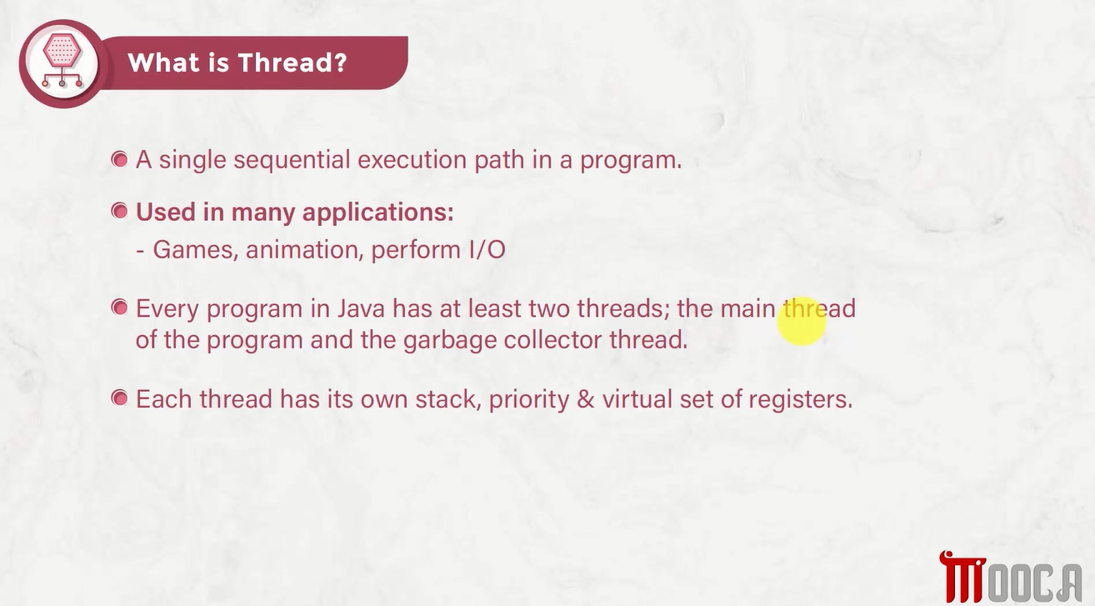

Slide 15
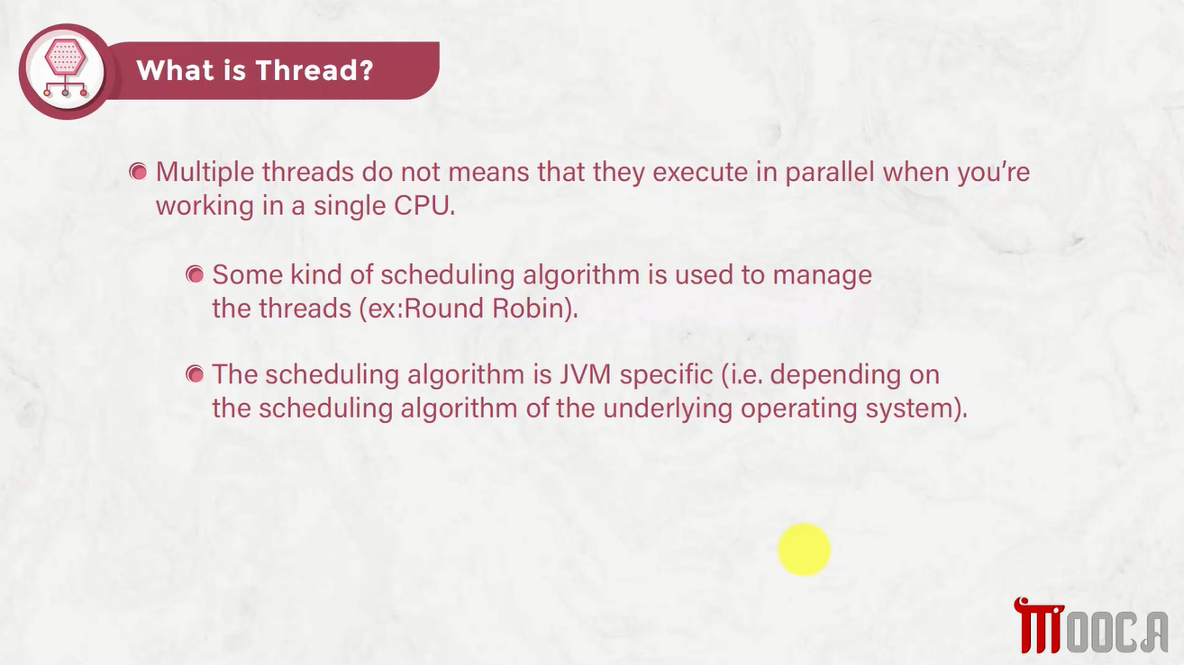

Slide 16
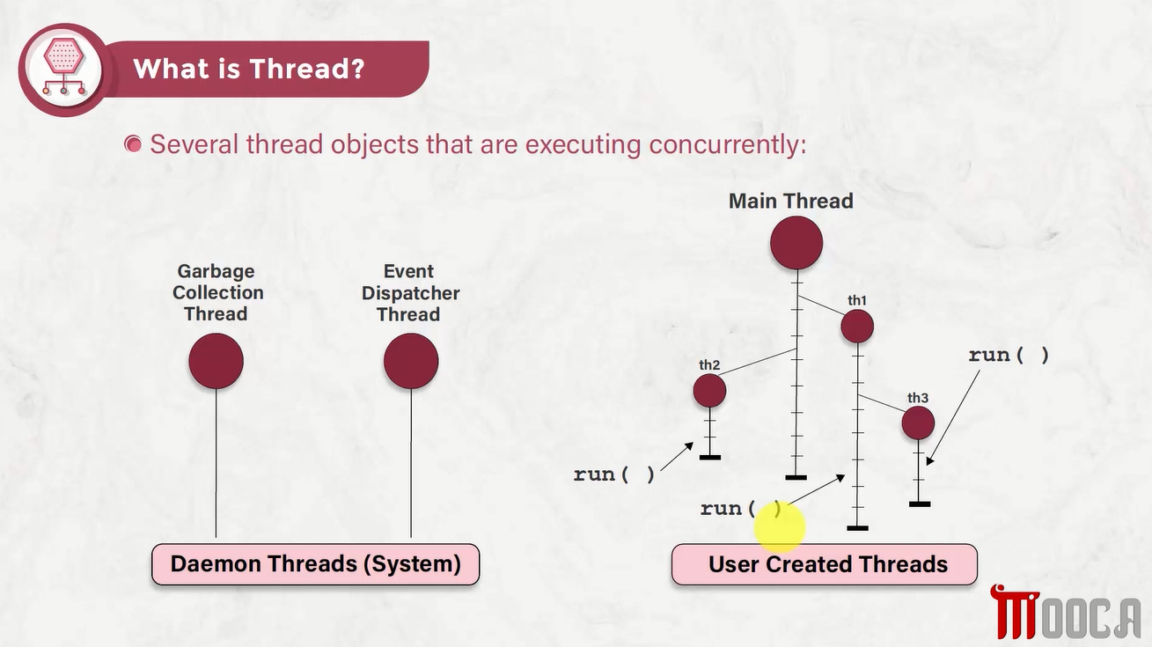



Slide 17
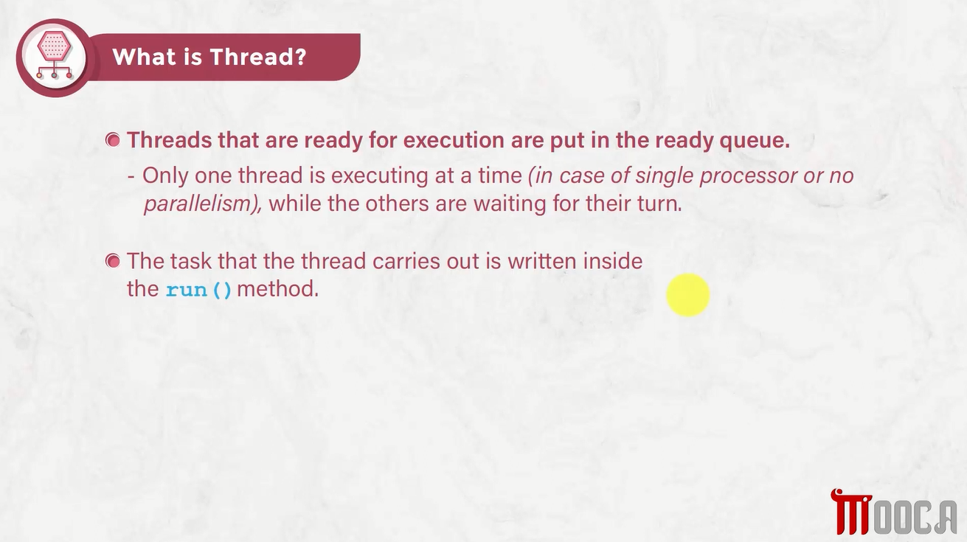

Slide 18
✍Sequential vs Concurrent Execution
Sequential : One task must finish before the next starts.
Task A → Task B → Task C
Concurrent : Multiple tasks can make progress during the same period.
Task A ────────
Task B ────────
Task C ────────

Slide 19





✍How Does Java Decide Which Thread Runs
Thread Scheduling :
The JVM and Operating System manage thread execution.
Threads compete for CPU time.
Execution order is not guaranteed.
Thread priority does not guarantee execution order

Slide 20
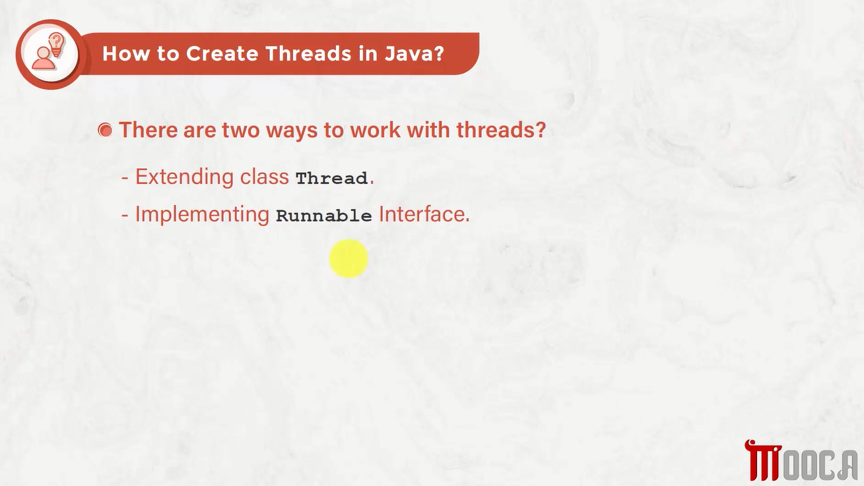

Slide 21
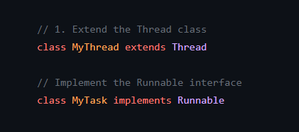


✍Creating a Thread in Java
There are two common approaches:
Extend the Thread class
Implement the Runnable interface

Slide 22
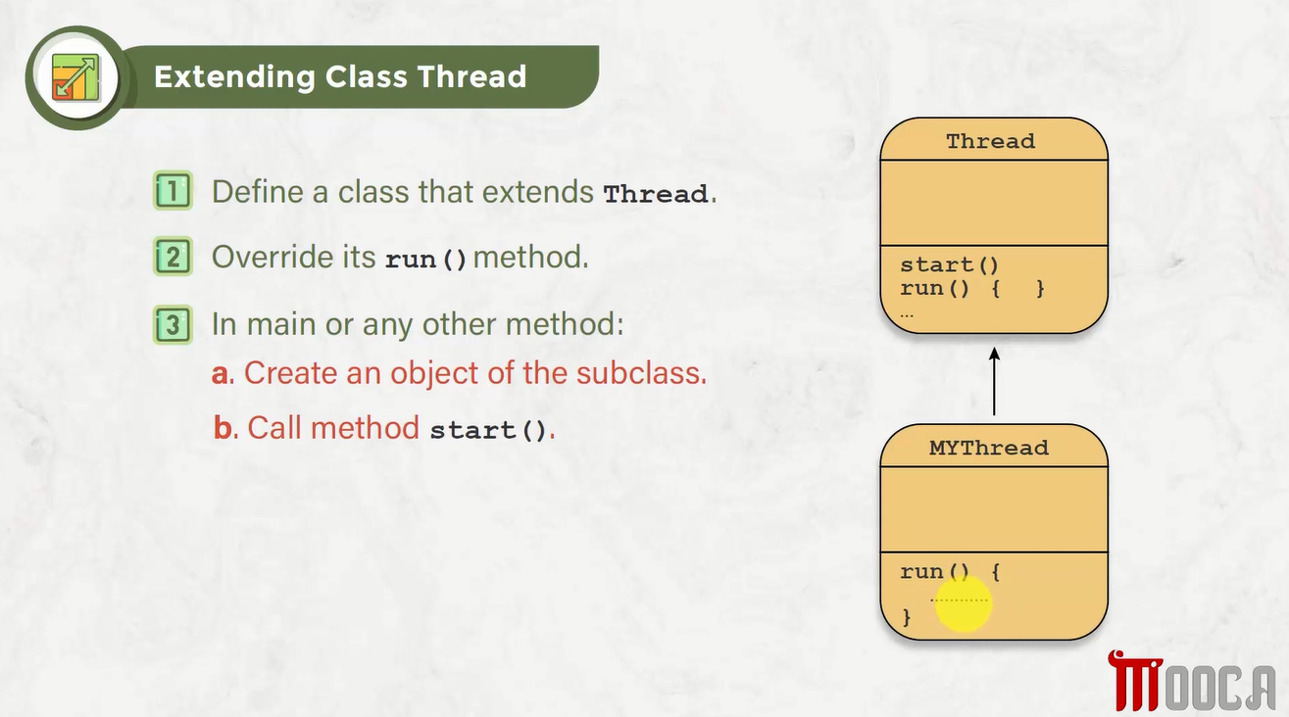






Slide 23
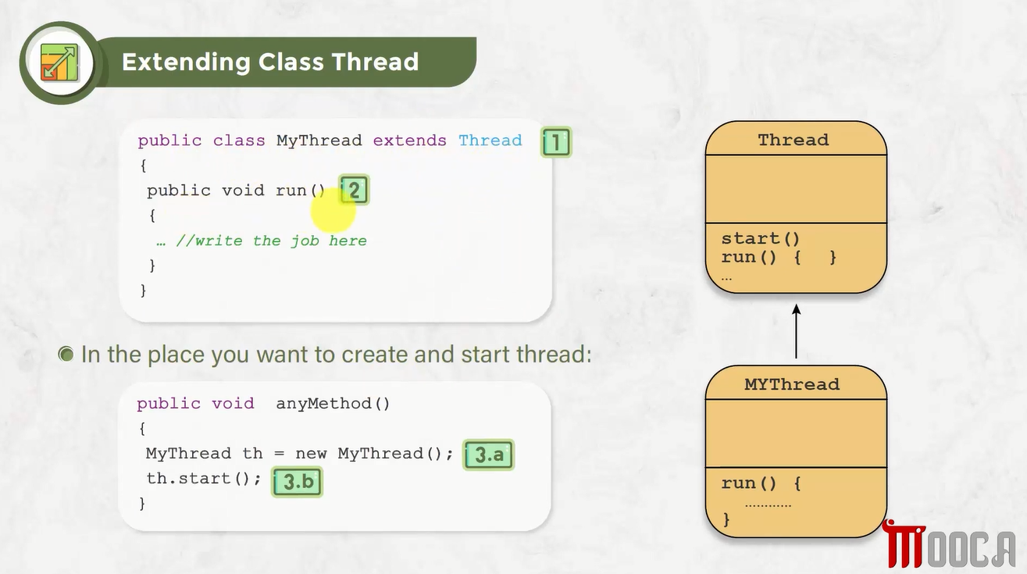









Slide 24
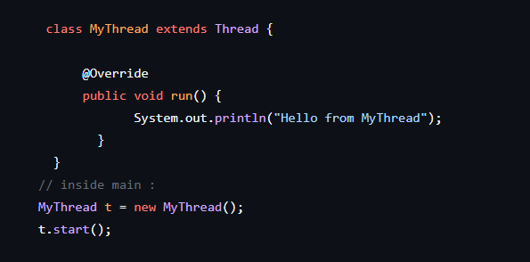
✍Extending the Thread Class

Slide 25
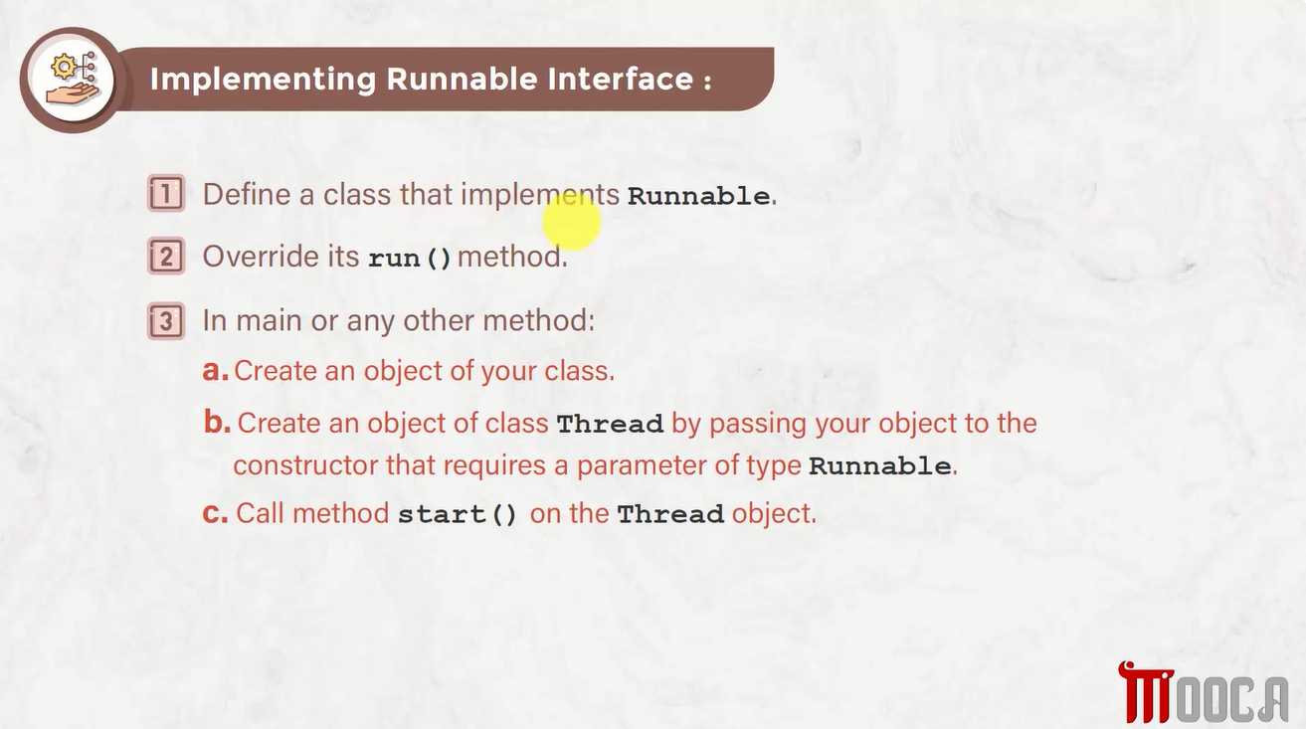






Slide 26
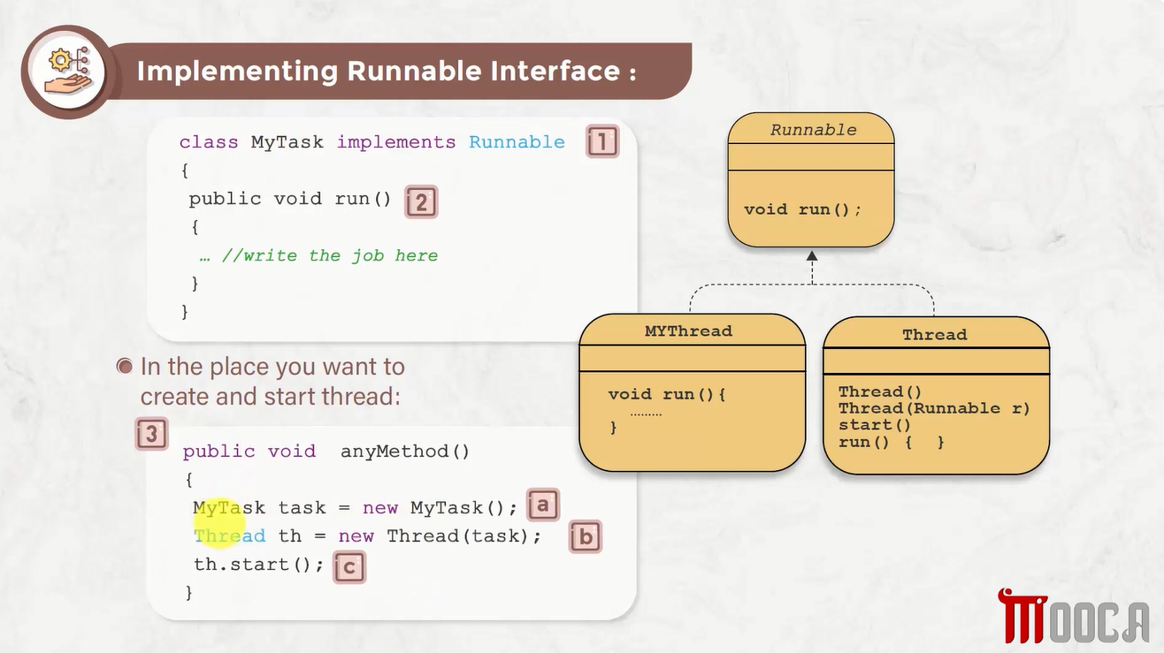





Slide 27
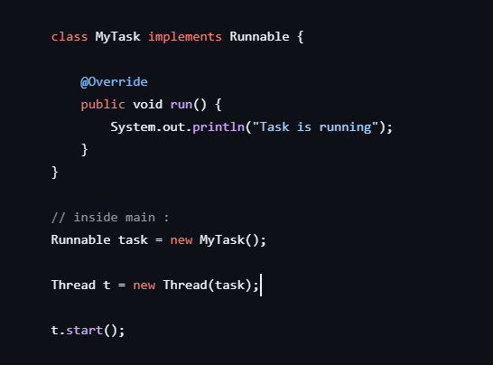





✍Implementing Runnable

Slide 28



✍start() vs run()
start() :
Creates a new thread of execution.
Eventually calls run()
run():
Normal method call.
Does not create a new thread.

Slide 29
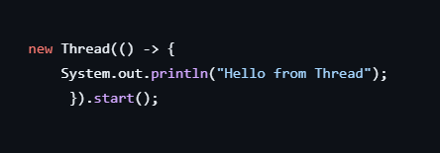
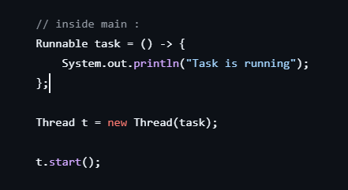
✍Runnable with Lambda Expressions
Because Runnable has one abstract method, we can use a lambda:

Slide 30
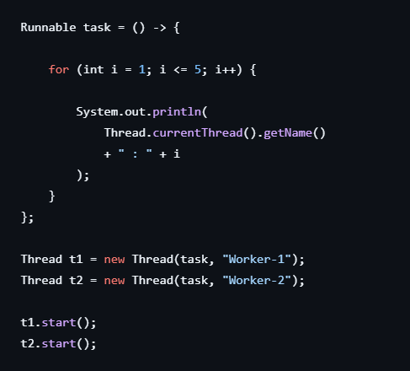






✍Running Multiple Threads

Slide 31
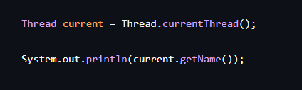


✍Thread.currentThread()
Getting the Current Thread

Slide 32
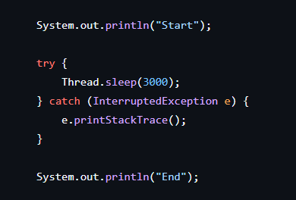


✍Thread.sleep()
Pauses the current thread for a specified amount of time.

Slide 33
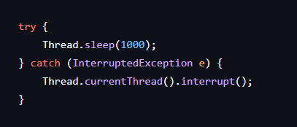

✍ Handling InterruptedException
Methods such as sleep() and join() can throw:

Slide 34
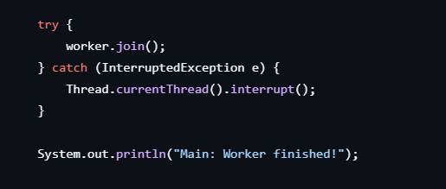
✍join()
join() makes one thread wait for another thread to finish.

Slide 35
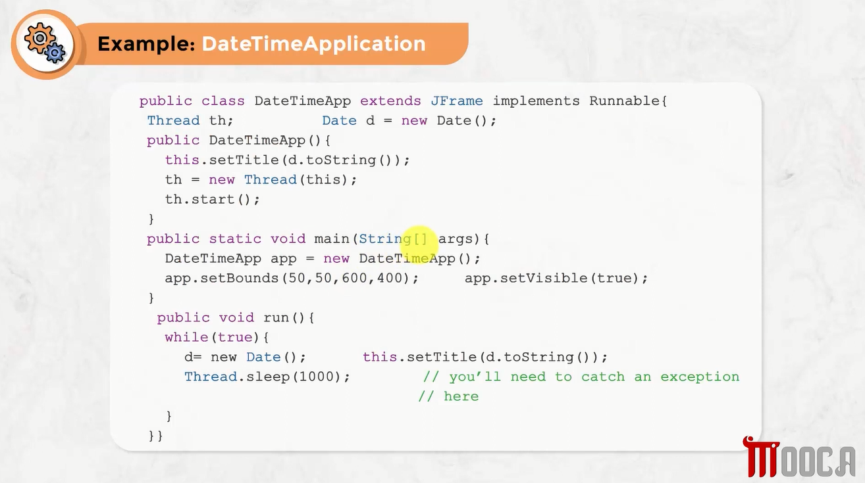








Slide 36
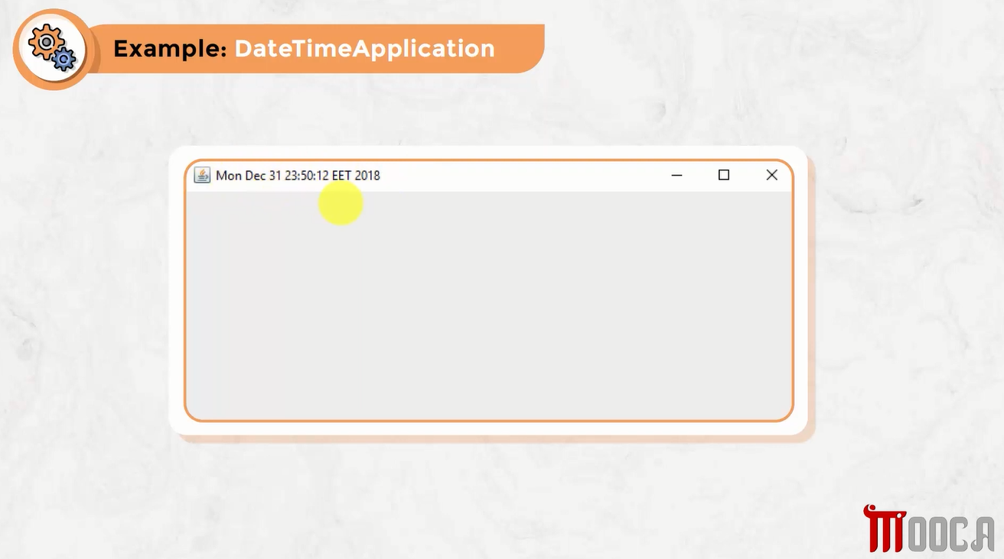


Slide 37
